Slide 1
Math 1050
3.5 Shifting, Reflecting, and Stretching

Slide 2
In this section, you will learn how to:
Shift graphs (left, right, up, down)
Reflect graphs (across the x or y axis)
Stretch graphs (or shrink)
You may also look at a graph and be asked to explain what happened to the “original” graph.
You must first recognize the graphs of common functions.

Slide 3
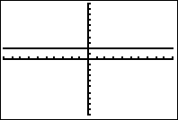
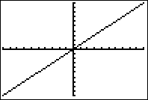
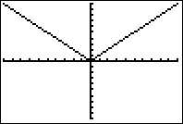
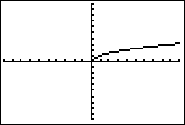
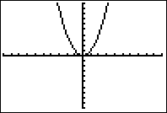
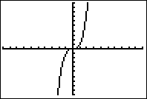
Pg 215 Common Functions

Slide 4
Important Points in Common Functions

Slide 5
Important Points in Common Functions

Slide 6
Important Points in Common Functions

Slide 7
Important Points in Common Functions

Slide 8
Important Points in Common Functions

Slide 9
Important Points in Common Functions

Slide 10
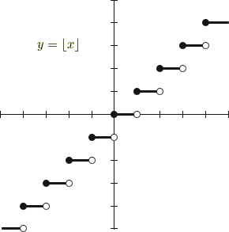
Important Points in Common Functions

Slide 11
Parent Functions
Each of the functions in the family of functions is considered a “parent function” or “common function” for any function that has the same shape.
Example:

Slide 12
Using Parent Functions
We can use the “parent function” to:
1. Find the function when given the graph of the function.
2. Graph functions (without a calculator).

Slide 13
Transformations of Graphs
A graph can be transformed in 3 different ways:
1. Shifting (up or down, left or right)
2. Reflecting (over x or y axis)
3. Stretching (make shape bigger or smaller)

Slide 14
Shifting
Vertical shift c units upward:
Vertical shift c units downward:
Horizontal shift c units to the right:
Horizontal shift c units to the left:

Slide 15
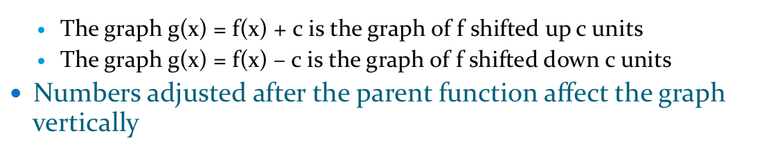
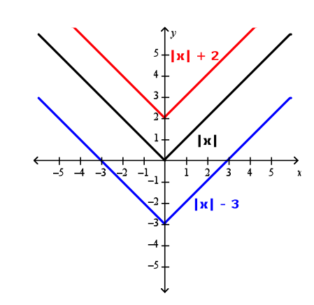

Slide 16
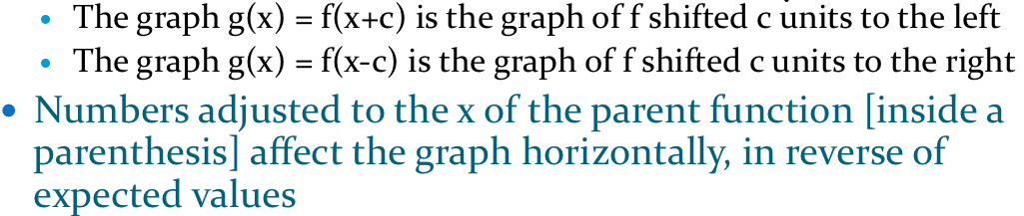
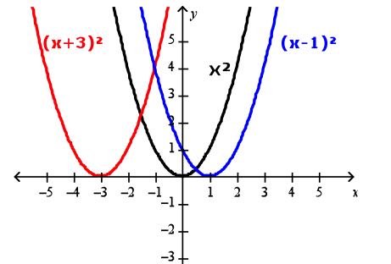

Slide 17
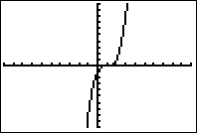
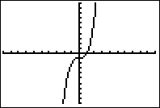
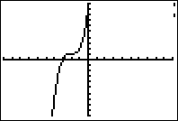
Shifts down 1.
Shifts to the right 1.
Shifts to the left 2 and up 1.

Slide 18
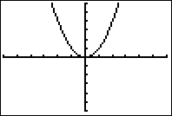
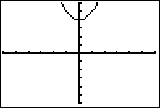
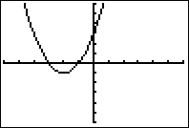
f
(
x
=
2
y=f(x)
)
x
y=g(x)
y=h(x)

Slide 19
Reflections
h(x)=-f(x) reflects across the x axis.
h(x)=f(-x) reflects across the y axis.
If it happens outside the function, reflects across the x axis.
If it happens inside the function, reflects across the y axis.

Slide 20
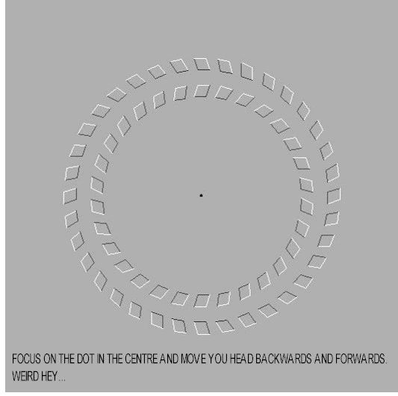
Optical Illusion

Slide 21
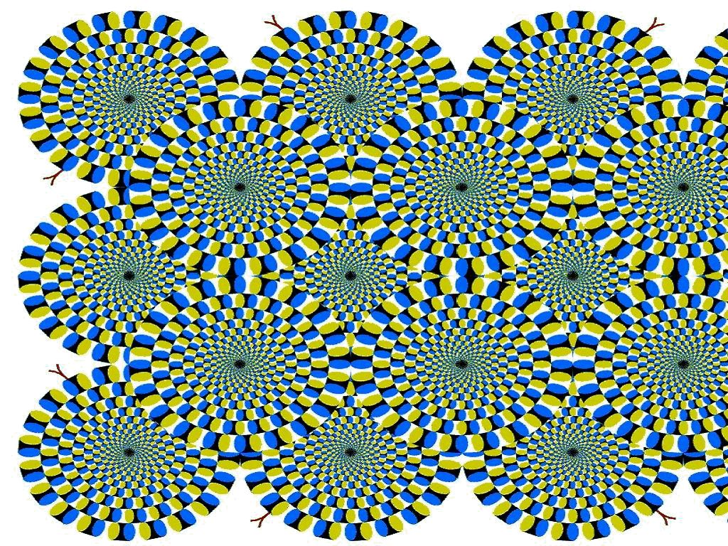
Optical Illision

Slide 22
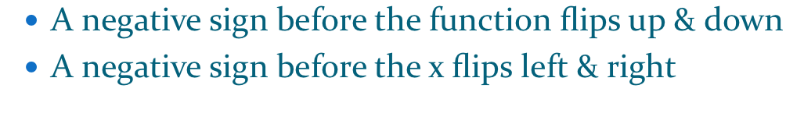
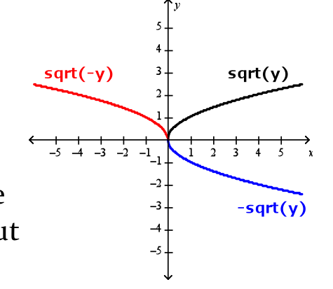

Slide 23
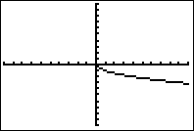
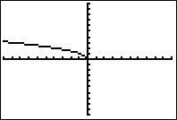
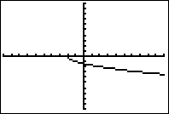
Example
Compare the graph of each function with the graph of
Reflects across the x axis.
Reflects across the y axis.
Reflects across the x axis.
Shifts to the left 2 units.

Slide 24
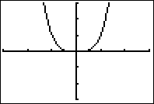
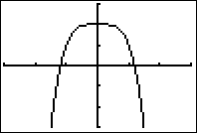
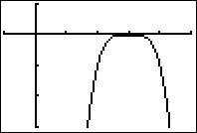
Example
y=g(x)
y=h(x)

Slide 25
Take a 5 Minute Break
http://www.youtube.com/watch?v=SEBLt6Kd9EY&safety_mode=true&persist_safety_mode=1&safe=active

Slide 26
Stretching
Vertical stretch or shrink(compression):
Horizontal stretch
or shrink (compression):

Slide 27
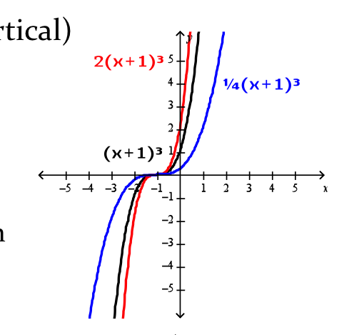

Slide 28
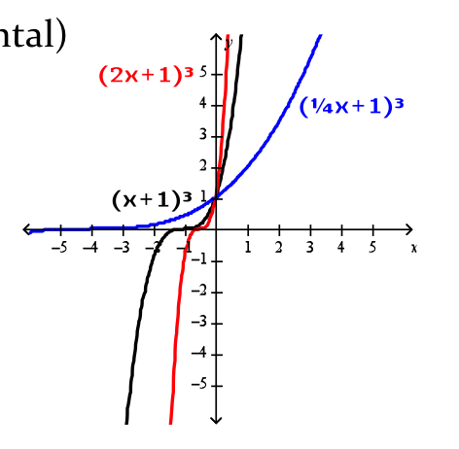

Slide 29
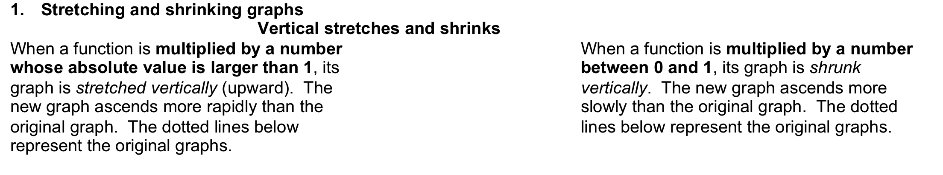
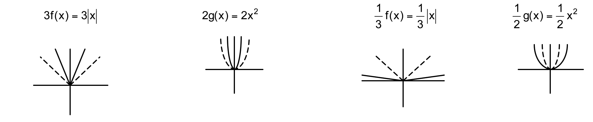
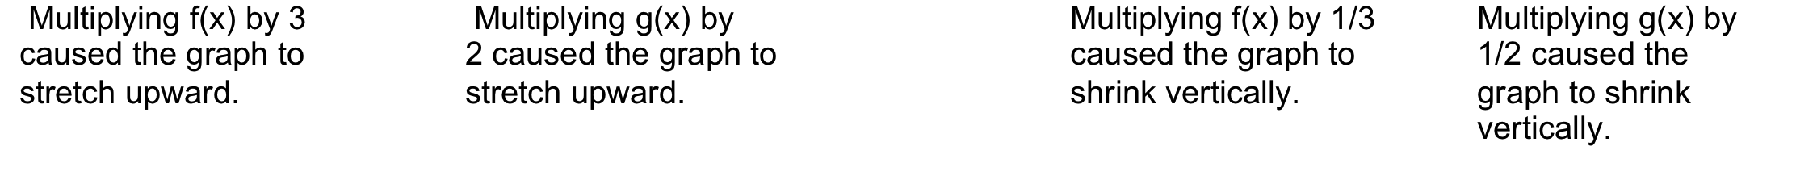

Slide 30
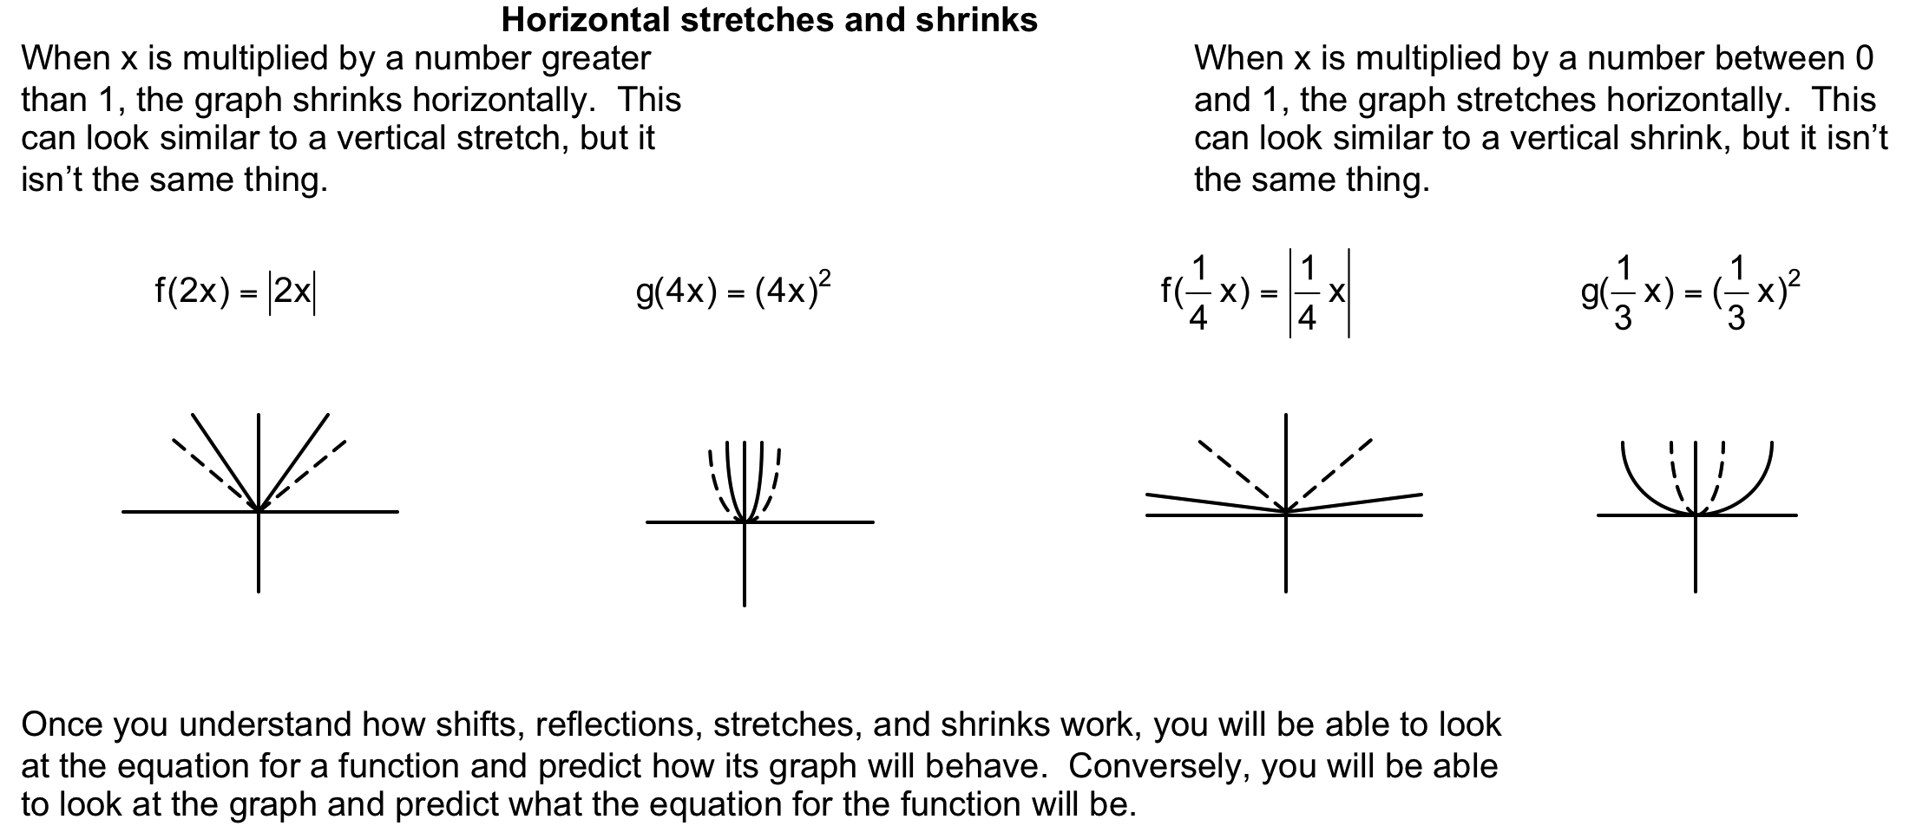

Slide 31
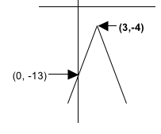
Write the equation for the function whose graph is seen below. Build the equation by determining one element at a time.

Slide 32
Find the function when given the graph of the function.

Slide 33
Find the function when given the graph of the function.

Slide 34
Find the function when given the graph of the function.

Slide 35
Graph the function
(without a calculator).

Slide 36
Graph the function
(without a calculator).

Slide 37
Graph the function
(without a calculator).

Slide 38
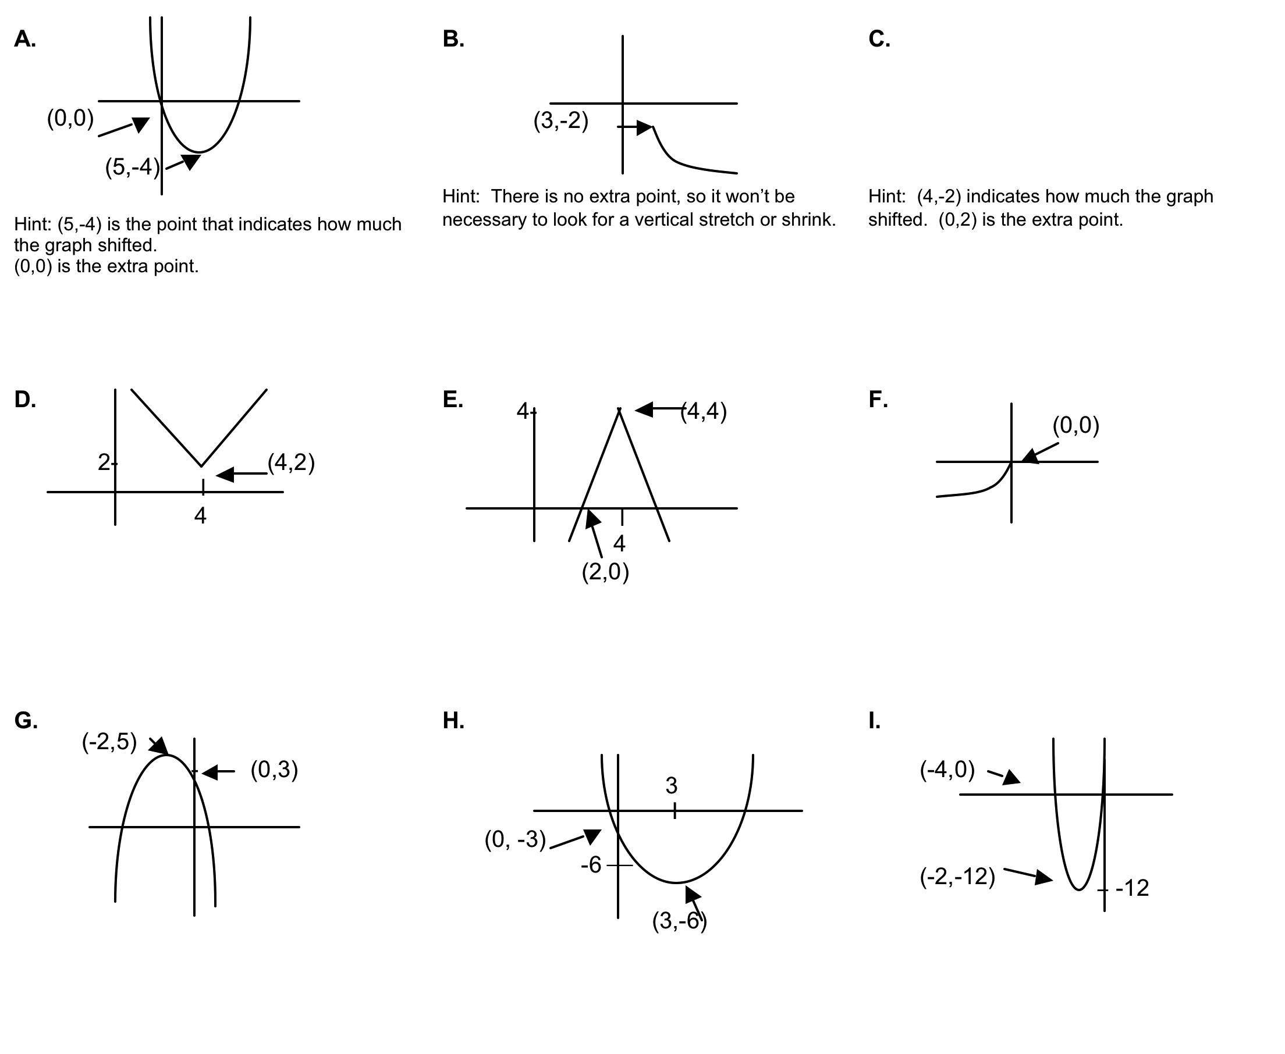
Refer to Handout

Slide 39
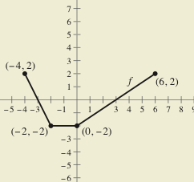
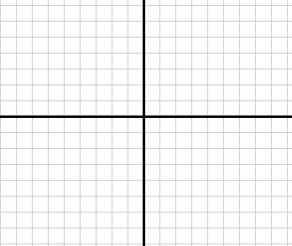

Slide 40
3.5 Homework

