Slide 1
3rd Quarter Test Review

Slide 2
a)

Slide 3
b)

Slide 4
c)

Slide 5
Use logarithms to find the exact values:
a)

Slide 6
Use logarithms to find the exact values:
b)

Slide 7
Use logarithms to find the exact values:
c)

Slide 8
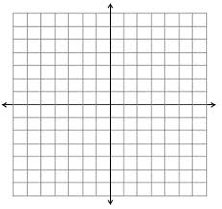

Slide 10
Calculator Portion
a)

Slide 11
b)

Slide 12
c)

Slide 13
d)

Slide 19
